Slide 1

Gradient Descent
Notes:
Welcome to Practicum AI Foundations of Deep Learning – Gradient Descent.

Slide 2

Lesson Overview
1. The Big Picture
2. The Loss Function
3. A Race to the Bottom
4. Optimizers
Notes:
In this lesson, we will:
Introduce the backpropagation process – its basic parts and the relation of those parts to each other.
Take a closer look at the loss (error) function, more specifically its contour.
Present the logic of learning and how one finds the bottom of a loss function contour in relation to the learning rate hyperparameter.
Consider the key role optimizers play in real-world neural network learning

Slide 3
Bias Node
X₀
G₀
Network Output
W_{xg0}
W_{gf0}
X₁
W_{xg1}
G
F
E
W_{gf1}
Input Features
Error
X₂
W_{xg2}
y_{truth}
Input Layer
Hidden Layer
Output Layer
Error/Loss Function
Forward Propagation
Notes:
To start us off, let’s do a quick review of forward propagation. A couple points:
During forward propagation, the flow of numbers is from left to right.
In this small network, all roads lead to node F, the single node in our output layer. Node F then passes the network’s final prediction (output) to an error function, also known as a loss function. The loss function, in turn, calculates the network’s total error, being the difference between ground truth (labelled Y) and the network’s prediction.
To properly understand gradient descent, we must take a closer look at the error/loss function…

Slide 4
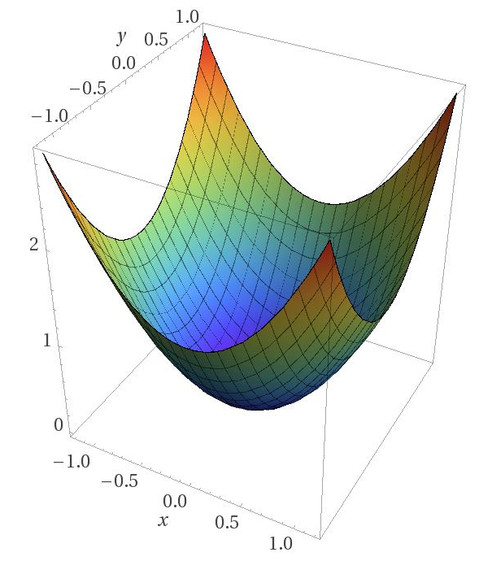
Image Credit: https://blog.paperspace.com/intro-to-optimization-in-deep-learning-gradient-descent/
Notes:
We begin by plotting the contour of our error function in 3-dimensions (x, y, and z).
Naturally, this example has been greatly simplified to facilitate understanding. Even so, the underlying logic holds, whether the contour is simple or complex. Now at the start of training, a network’s total error is usually high, with a large difference between its prediction and what we expect (ground truth).
In this simulation – the error function…
2. … calculated an initial error located near one of the contour’s tips…
3. … far from the bottom or global minimum.
4. So, what we want to do is “walk” down this slope or gradient, from that initial starting point to the end point at the bottom. And because the network is
moving down a gradient, the process is called gradient descent.
But this raises an interesting question. How does the network figure out which way to go? How does it know which way is down?
To answer that question…

Slide 5
y
1.0
0.8
0.6
0.4
0.2
x
-1.0
-0.5
0.5
1.0
Notes:
… we reduce our 3-dimensional contour, making it a two-dimensional graph. We then add a point to indicate our current location. Now, imagine you are standing on this point and a dense fog surrounds you, making it impossible to see the bottom of the valley. All you can feel is the slope of the ground below your feet. So, how would you proceed? Well, just take a step downhill in the direction indicated by the steepest slope.
And to calculate that slope, we…

Slide 6
y
1.0
0.8
0.6
0.4
Tangent Line
0.2
Derivative = Slope
x
-1.0
-0.5
0.5
1.0
Source: Glassner, A. (2021). Deep learning: A visual approach. San Francisco, CA: No Starch Press. (page 355)
Notes:
… draw a tangent line through a given point and then calculate its slope as the derivative of a partial differential equation. In other words, the derivative is the slope of the gradient at a particular point. If the gradient directly above the weight is positive (the line goes up as we move to the right), then increasing the value of the weight (moving it to the right) causes the error to go up. Likewise, decreasing the value of the weight (moving it to the left) causes the error to go down. We see that with the gold line. But if the slope of the error is negative (the line goes down as we move to the right), the logic is reversed. As is the case with the purple line.
A couple key points –
The error curve for each weight in a network is different because each weight has a different effect on the total error. But if we can calculate the gradient for a specific weight, we know whether it should increase or decrease. And if we can calculate the gradients for all the weights, we can adjust them all at once, rather than one by one. That’s what backprop does.
The slope of a tangent line varies depending on its location. For example, the slope of the purple line is smaller than the gold one. In other words – as you approach the global minimum at the bottom – the slope gets smaller and smaller until it’s zero. When that happens, the neural network ‘knows’ it has found the best possible solution.

Slide 7
Cost
0
Start
The learning rate is too small
Source: Geron, A. (2021). Hands-On Machine learning with Sci-Kit Learn, Keras & Tensorflow. Sebastopol, CA: O’Reilly. (Chapter 4)
Notes:
Once we know the slope at our current location, we know which way to go. So, our next question is: What size of step should we take? The model’s learning rate answers that question. It tells the optimizer how big or small each step should be. This is an important hyperparameter, one of those adjustable settings you need to keep an eye on. If our learning rate is too small, it takes a long time (many iterations) to arrive at the global minimum.
On the other hand, …

Slide 8
Cost
0
Start
The learning rate is too large
Source: Geron, A. (2021). Hands-On Machine learning with Sci-Kit Learn, Keras & Tensorflow. Sebastopol, CA: O’Reilly. (Chapter 4)
Notes:
… if the learning rate is too high, you might jump across the valley and end up on the other side, possibly at a location higher than before. So, a large learning rate might cause the algorithm to diverge, unable to find the global minimum as it jumps around it.

Slide 9
Image Credit: https://blog.paperspace.com/intro-to-optimization-in-deep-learning-gradient-descent/
Notes:
Another complicating factor is the fact that the loss function’s contour may not look like a nice, regular bowl. So far, I’ve used a simple example to facilitate a foundational understanding. But reality is often much more complex. A contour may have holes, ridges, plateaus, and all sorts of irregular terrains, making convergence to the global minimum difficult to achieve, if not impossible.

Slide 10
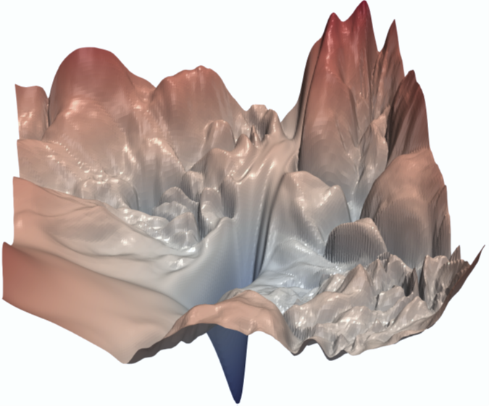
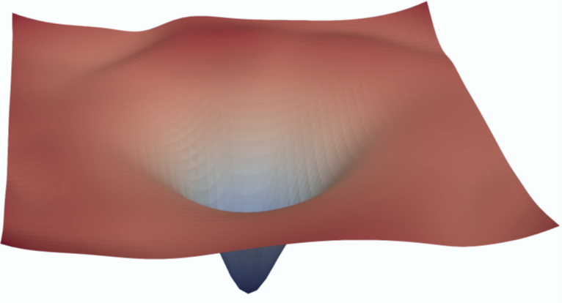
ResNet-56 Model
(a) with skip connections
(b) without skip connections
Source: Li, H., et. al. (2018). Visualizing the Loss Landscape of Neural Nets. NeurIPS 2018, Montreal, CA
Notes:
The architecture of a model and its trainable weights determines the contour of the loss function. Here we see the loss surface of a ResNet-56 model, with and without skip connections. (A skip connection allows us to jump over layers in a neural network) As we see here, a slight change in model architecture can have a dramatic effect on the loss contour and whether a model is or is not trainable. To create visualizations like these, we must reduce a high-dimensional space to 3 dimensions. And yes, this is a complex and highly mathematical process, well beyond the scope of this learning experience.
Article Link: https://proceedings.neurips.cc/paper/2018/file/a41b3bb3e6b050b6c9067c67f663b915-Paper.pdf

Slide 11
Cost
Plateau
Local minimum
Global minimum
Gradient Descent pitfalls
Source: Geron, A. (2021). Hands-On Machine learning with Sci-Kit Learn, Keras & Tensorflow. Sebastopol, CA: O’Reilly. (Chapter 4)
Notes:
With complex contours, it can be hard to find a global minimum. Consider this image. If we start on the left, then gradient descent might converge to a local minimum that is not as good as the global minimum. If we start, however, on the right, it might take too long to cross the plateau. In that case, stop too early and one never finds the global minimum. Can we overcome this problem?

Slide 12
Source: Geron, A. (2021). Hands-On Machine learning with Sci-Kit Learn, Keras & Tensorflow. Sebastopol, CA: O’Reilly. (Chapter 4)
Notes:
In recent years, a lot of research has focused on the problem of adjusting the learning rate when a loss function contour has many ridges, valleys, and plateaus. Keep in mind – it’s the optimizer’s job to find that global minimum.
The ADAM (Adaptive momentum) optimizer is a popular choice. ADAM’s basic strategy can be described like this:
First, imagine a marble placed near the top of a hill.
We then release the marble, and it begins to roll downhill, picking up speed as it goes. Hopefully, the marble’s momentum is enough for it to “jump” over trenches (local minima)…
… before ending up at the bottom.

Slide 13

Gradient Descent Game
Notes:
https://www.i-am.ai/gradient-descent.html

Slide 14
Exercise
(A Keras Classifier) 03.1_keras_classifier.ipynb
Notes:
The learning experience for this workshop starts on page 79 of the textbook. For additional information, please watch the exercise 2.01 orientation video.

Slide 15
The Chain Rule
Notes:
Welcome to Practicum AI Foundations of Deep Learning – Gradient Descent.

Slide 16


X₀
G₀
X₁
W_{xg0}
W_{gf0}
W_{xg1}
G($δ$)
F($δ$)
Q
E
W_{gf1}
Error
W_{xg2}
X₂
Input Layer
Hidden Layer
Output Layer
Optimizer
Error/Loss Function
Back Propagation
Notes:
As network parameters or weights are updated during backpropagation, the chain-rule plays an important role in that process. Let’s begin with a quick review. After the error function passes its calculation of the network’s total error to the optimizer, the optimizer then propagates that error back through the network, adjusting weights to minimize the total error. More concretely, the network must calculate the individual contribution of each weight to the total error and then adjust each (up / down) in relation to its contribution to that error.
Interestingly, all these weights are linked together. And that creates an interesting situation…

Slide 17
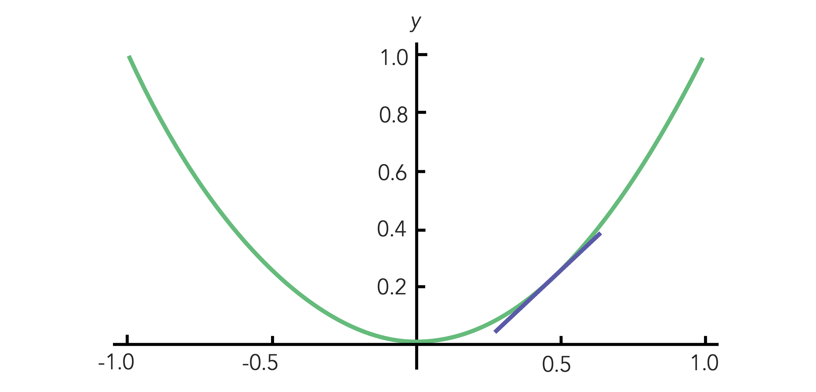
1
1
X₁
E
Label
F
Loss
Input Features
Probability
Total Error (E)
W_{gf1}
X₂
G
Optimizer
W_{xg2}
Source: Taylor, M. (2017). Neural networks: A visual introduction for beginners. Vancouver, Canada: Blue Windmill Media.
Notes:
Consider this simple network.
Weight Wxg2 is linked to weight Wgf1 which, in turn, is linked to the Total Error.
Once the error function calculates the total error, its location on the gradient, and the slope (derivative) at that location, it hands that off to the optimizer…
… which then walks this error back through all the linked weights, calculating the slope (derivative) of each, and then adjusting the weights in the direction indicated.
Calculus provides a way of managing these linked weights. It’s called the chain rule. As its name suggests, the chain rule allows the optimizer to walk backwards through a set of linked weights. In this example, the optimizer follows the red arrows, from Total error to weight Wgf1 and then weight Wxg2. And, the same logic applies to all the weights, including bias.

Slide 18
Notes:
Let’s now simulate the chain rule using the two weights and total error from the previous slide. The relationship between the network’s error gradient and the first weight (Wgf1) is shown in the graph at the bottom. As we move down that gradient towards a global minimum, the link – the purple dashed line – ensures that the partial derivative between Wgf1 and Wxg2 is adjusted in relation to the network’s total error.
So, in this example, we move up the Wgf1 / Wxg2 gradient as the optimizer moves toward the global minimum, as shown in the bottom graph.

Slide 19
Source: https://medium.com/swlh/introduction-to-deep-learning-using-keras-and-tensorflow-part2-284746ab4442
Notes:
And finally, let’s zoom out and consider the training process from the perspective of the overall model. Here we see the training process (the process of model convergence) simulated for a linear regression model. As our model converges to a global minimum – that is, the model’s fit improves as the regression line moves – our training loss drops and adjustments to our parameters (weights and biases) levels off.

Slide 20
Summary
Error (Loss) Function
Gradient Descent & Partial Derivatives
Complex Gradients
Optimizers
Chain Rule
Notes:
Well, we have covered a lot of territory in this presentation. First, we discussed the loss function and a network’s total error. That was followed by an in-depth look at gradient descent and the use of partial differential equations to calculate the derivative or slope at a given point on the gradient. We also learned that most loss functions exhibit complex contours, featuring hills, values, and plateaus, making it difficult to locate the global minimum. And finally, I discussed how backpropagation employs the chain rule to determine the contribution of each weight to the total error in relation to the other weights.

Slide 21
Exercise
(MNIST Exercise)
03.2_mnist_classifier.ipynb
Notes:
MNIST (Modified National Institute of Standards and Technology) is a famous dataset of handwritten digits with 60,000 examples in the training set and 10,000 in the test set. MNIST was created in 1998 – a long, long time ago in AI time. Creating a deep learning model to correctly classify a given image is equivalent to writing a “Hello World” program in AI.

Slide 23
W_{xg2}
W_{gf1}
W_{gf1}
Total Error

Slide 24
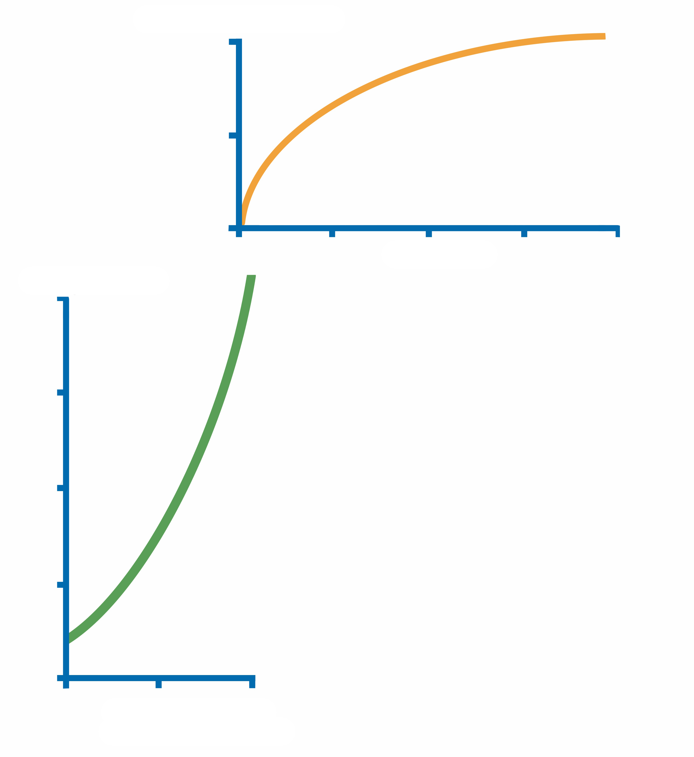
w_{xg2}
W_{xg2}
w_{gf1}
w_{gf1}
W_{gf1}
W_{gf1}
Total Error
Total Error

Slide 25
W_{xg2}
W_{gf1}
W_{gf1}
Total Error

Slide 26
W_{xg2}
W_{gf1}
W_{gf1}
Total Error

Slide 27
W_{xg2}
W_{gf1}
W_{gf1}
Total Error

Slide 28
W_{xg2}
W_{gf1}
W_{gf1}
Total Error

Slide 29
W_{xg2}
W_{gf1}
W_{gf1}
Total Error

